Slide 1

Delivery Detective
AI-Powered E-Commerce Delivery Optimization
Building an intelligent, data-driven system that analyzes delivery issues using NLP, computer vision, weather data, and advanced AI analytics to optimize routes, enhance resilience, and elevate customer satisfaction.
Vaishnawi Pandey (24MBMB08)

Slide 2

The Delivery Challenge
Current Pain Points
Our Approach
Weather delays and route inefficiency
Fuse AI with multi-source data
Poor packaging causing damage
Identify root causes systematically
Fragmented data across systems
Quantify resilience with DRI metric
Unpredictable delivery reliability
Deliver transparent, explainable insights

Slide 3
System Architecture
A comprehensive data pipeline integrating customer feedback, environmental conditions, and logistics data through advanced AI layers.
01
02
Data Gathering
Feature Engineering
Customer reviews, weather feeds, package images, GPS coordinates
Sentiment scoring, weather severity, damage indicators, route metrics
03
04
AI Modeling
Intelligent Querying
NLP for sentiment, computer vision for damage, analytics for DRI computation
RAG engine with FAISS and LLMs for context-aware recommendations
05
06
Route Optimization
Interactive Dashboard
NetworkX and OR-Tools for cost minimization and efficiency gains
Streamlit visualization with maps, insights, and real-time analytics

Slide 4

Results & Impact
10%
3
Cost Reduction
Dashboard Modules
Average travel cost per route optimized
DRI insights, RAG Q&A, route optimization
Key Achievements
Built integrated DRI dataset combining sentiment, weather, and damage signals
Deployed RAG engine for intelligent document-based querying
Identified low-DRI locations requiring logistic improvements
Validated weather and sentiment as top delay risk predictors

Slide 5

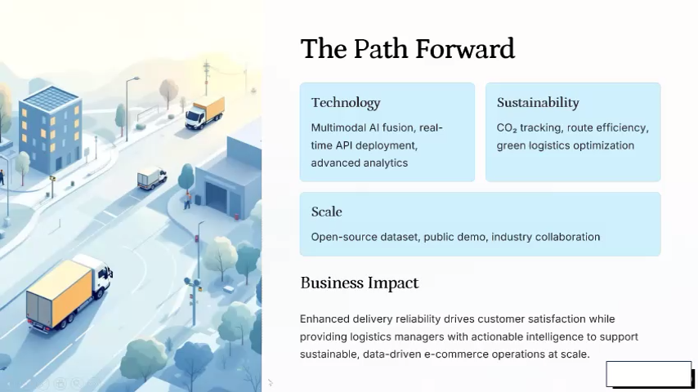
The Path Forward
Technology
Sustainability
Multimodal AI fusion, real-time API deployment, advanced analytics
CO₂ tracking, route efficiency, green logistics optimization
Scale
Open-source dataset, public demo, industry collaboration
Business Impact
Enhanced delivery reliability drives customer satisfaction while providing logistics managers with actionable intelligence to support sustainable, data-driven e-commerce operations at scale.

